Slide 1


Classifying News from Social Media Platforms as Real and Fake
Arvind Balaji Narayan, Gopik Anand, Vasanth Kolli
Abstract
Results
Conclusion
In the age of internet, information is freely and easily accessible. It comes with its own benefits and risks. One major bane is misinformation. Misinformation is prevalent in every social media platform, Facebook, TikTok, Snapchat, Reddit, Whatsapp, Instagram, Twitter, etc. These pose extreme risk right from affecting elections to posing grave health risks as we observed during the COVID-19 pandemic and in certain cases might also lead to fatalities. A major source of this is fake news. Most people are usually led to believe that news structured in a formal way should ideally be from a reliable news source, but it is often not. The rapid advancements in NLP can help us tackle this problem and help identify news as either real or fake. Our models are trained on a Kaggle Dataset that obtains news data from reputed and trustable news sources. The trained models are then used for the classification of news from social media sources such as Twitter & Reddit as either real or fake.
Model Name | Test: Reddit |  | Test: Twitter |  | Test: Reddit + Twitter
 | Accuracy | F1-Score | Accuracy | F1-Score | Accuracy | F1-Score
Naive Bayes | 0.3559 | 0.3559 | 0.5048 | 0.5048 | 0.4520 | 0.4520
SVM | 0.4613 | 0.4613 | 0.5111 | 0.5111 | 0.4934 | 0.4934
BiLSTM | 0.4412 | 0.4412 | 0.5136 | 0.5136 | 0.4849 | 0.4849
TextCNN | 0.4469 | 0.2760 | 0.5624 | 0.5694 | 0.5052 | 0.4916
RoBERTa | 0.7969 | 0.7969 | 0.9190 | 0.9190 | 0.8869 | 0.8869
AlBERT | 0.5136 | 0.6786 | 0.5941 | 0.5560 | 0.5655 | 0.6144
DistilBERT | 0.8215 | 0.8215 | 0.8903 | 0.8903 | 0.8429 | 0.8429
Canine | 0.7942 | 0.8853 | 0.8963 | 0.9018 | 0.8601 | 0.8938
GPT-2 | 0.8009 | 0.8895 | 0.8918 | 0.8953 | 0.8532 | 0.8870
DeBERTa | 0.8020 | 0.8901 | 0.9126 | 0.9187 | 0.8733 | 0.9050
Electra | 0.8256 | 0.8256 | 0.8868 | 0.8868 | 0.8767 | 0.8767
XLM-RoBERTa | 0.8026 | 0.8026 | 0.9185 | 0.9185 | 0.8951 | 0.8951
XLNet | 0.8168 | 0.8168 | 0.8995 | 0.8995 | 0.8825 | 0.8825
BERT | 0.8221 | 0.8221 | 0.8880 | 0.8880 | 0.8628 | 0.8628
LinkBERT | 0.8127 | 0.8967 | 0.9202 | 0.9259 | 0.8821 | 0.9118
We observe that the models perform well in the news classification task. The deep learning models perform better than the traditional ML methods. A curious thing to note is that the CNN (Text CNN) and LSTM (BiLSTM) models performed at levels in close comparison with those of baseline methods. However, all the transformer models performed significantly better than the baseline ML, the CNN and the LSTM based models.
The accuracies produced by the Transformer models were good enough to classify the majority of the news data correctly. We also observe that the transformer models generalize well and one aspect to this might be because these models were pre-trained general language models and thus did not overfit on the training dataset.
Social Impact
Dataset
In a real-life setting where people largely consume news from social media handles, there is a huge possibility that we might be consuming fake news without knowing it and spread this out to friends, relatives and others which might lead to confusion and even pave the way to serious repercussions later on. In such cases, It would be great if people can actually have a system/setup to filter out the real news from the fake ones so that they can take the right and appropriate action (whatever it might be). They can also share the right news with others. This is where Ground Zero plays its part. By being able to distinguish between real and fake news seamlessly, we can provide a setup where people access the right content always.
The train dataset is a news classification dataset from Kaggle which contains ~45K news samples with a roughly equal distribution of real and fake news samples.
We created a new dataset for the test set by scraping news samples from social media sites such as Reddit and Twitter.
The data set scraped from Reddit has ~5K news samples and the data scraped from twitter has ~10K samples.
Methods
We focus primarily on deep learning methods to classify news as fake or real. We used results from traditional ML models such as Naïve Bayes and SVM’s as our baseline. This was followed by the deployment of Deep Learning NLP models with different architectures such as CNN, LSTM and many Transformers models.
The models were trained on the Kaggle dataset and their performance was measured on the test dataset which were comprised of news samples scraped from social media sources.
References
1. Ahmed H, Traore I, Saad S. “Detecting opinion spams and fake news using text classification”, Journal of Security and Privacy, Volume 1, Issue 1, Wiley, January/February 2018.
Notes:
You can add your presentation notes here. This presentation template for research posters is fully editable so text, graphics and content can be updated to fit your own research needs.
Download more poster presentation templates from FPPT.com

Slide 2

Classifying News from Social Media Platforms as Real and Fake
Arvind Balaji Narayan Gopik Anand Vasanth Kolli
Pennkey: narvind ganand vasanthk

Slide 3
Abstract:
In the age of internet, information is freely and easily accessible. It comes with its own benefits and risks. One major bane is misinformation. Misinformation is prevalent in every social media platform, Facebook, TikTok, Snapchat, Reddit, Whatsapp, Instagram, Twitter, etc. These pose extreme risk right from affecting elections to posing grave health risks as we observed during the COVID-19 pandemic and in certain cases might also lead to fatalities.
A major source of this is fake news. Most people are usually led to believe that news structured in a formal way should ideally be from a reliable news source, but it is often not. The rapid advancements in NLP can help us tackle this problem and help identify news as either real or fake.
Our models are trained on a Kaggle Dataset that obtains news data from reputed and trustable news sources. The trained models are then used for the classification of news from social media sources such as Twitter & Reddit as either real or fake.

Slide 4
Dataset & Methods:
Dataset:
The train dataset is a news classification dataset from Kaggle which contains ~45K news samples with a roughly equal distribution of real and fake news samples.
We created a new dataset for the test set by scraping news samples from social media sites such as Reddit and Twitter.
The data set scraped from Reddit has ~5K news samples and the data scraped from twitter has ~10K samples.
Methods:
We focus primarily on deep learning methods to classify news as fake or real. We used results from traditional ML models such as Naïve Bayes and SVM’s as our baseline. This was followed by the deployment of Deep Learning NLP models with different architectures such as CNN, LSTM and many Transformers models.
The models were trained on the Kaggle dataset and their performance was measured on the test dataset which were comprised of news samples scraped from social media sources.

Slide 5
Results:
Trained: Kaggle, Test: Reddit
Trained: Kaggle, Test: Twitter
Trained: Kaggle, Test: Reddit + Twitter
Sl No | Model Name | Accuracy Score | F1-Score
1 | Naive Bayes | 0.3559 | 0.3559
2 | SVM | 0.4613 | 0.4613
3 | BiLSTM | 0.4412 | 0.4412
4 | TextCNN | 0.4469 | 0.2760
5 | RoBERTa | 0.7969 | 0.7969
6 | AlBERT | 0.5136 | 0.6786
7 | DistilBERT | 0.8215 | 0.8215
8 | Canine | 0.7942 | 0.8853
9 | GPT-2 | 0.8009 | 0.8895
10 | DeBERTa | 0.8020 | 0.8901
11 | Electra | 0.8256 | 0.8256
12 | XLM-RoBERTa | 0.8026 | 0.8026
13 | XLNet | 0.8168 | 0.8168
14 | BERT | 0.8221 | 0.8221
15 | LinkBERT | 0.8127 | 0.8967
Sl No | Model Name | Accuracy Score | F1-Score
1 | Naive Bayes | 0.5048 | 0.5048
2 | SVM | 0.5111 | 0.5111
3 | BiLSTM | 0.5136 | 0.5136
4 | TextCNN | 0.5624 | 0.5694
5 | RoBERTa | 0.9190 | 0.9190
6 | AlBERT | 0.5941 | 0.5560
7 | DistilBERT | 0.8903 | 0.8903
8 | Canine | 0.8963 | 0.9018
9 | GPT-2 | 0.8918 | 0.8953
10 | DeBERTa | 0.9126 | 0.9187
11 | Electra | 0.8868 | 0.8868
12 | XLM-RoBERTa | 0.9185 | 0.9185
13 | XLNet | 0.8995 | 0.8995
14 | BERT | 0.8880 | 0.8880
15 | LinkBERT | 0.9202 | 0.9259
Sl No | Model Name | Accuracy Score | F1-Score
1 | Naive Bayes | 0.4520 | 0.4520
2 | SVM | 0.4934 | 0.4934
3 | BiLSTM | 0.4849 | 0.4849
4 | TextCNN | 0.5052 | 0.4916
5 | RoBERTa | 0.8869 | 0.8869
6 | AlBERT | 0.5655 | 0.6144
7 | DistilBERT | 0.8429 | 0.8429
8 | Canine | 0.8601 | 0.8938
9 | GPT-2 | 0.8532 | 0.8870
10 | DeBERTa | 0.8733 | 0.9050
11 | Electra | 0.8767 | 0.8767
12 | XLM-RoBERTa | 0.8951 | 0.8951
13 | XLNet | 0.8825 | 0.8825
14 | BERT | 0.8628 | 0.8628
15 | LinkBERT | 0.8821 | 0.9118

Slide 6
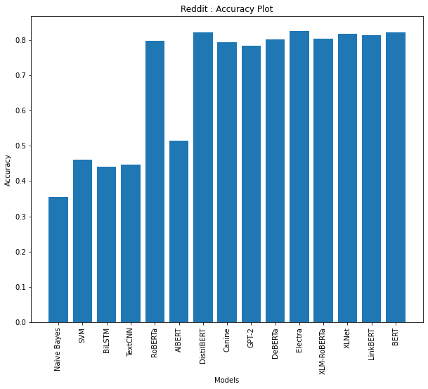
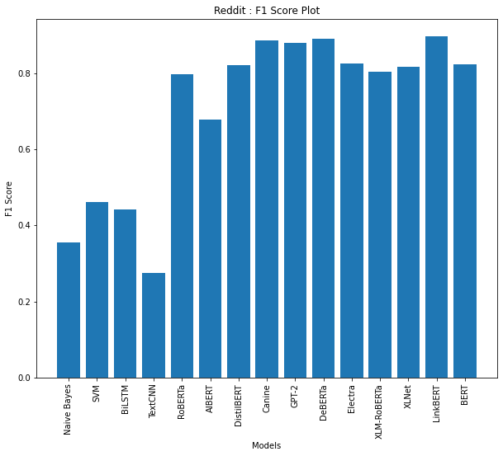
Accuracy and F1-score Results Train: Kaggle | Test: Reddit

Slide 7
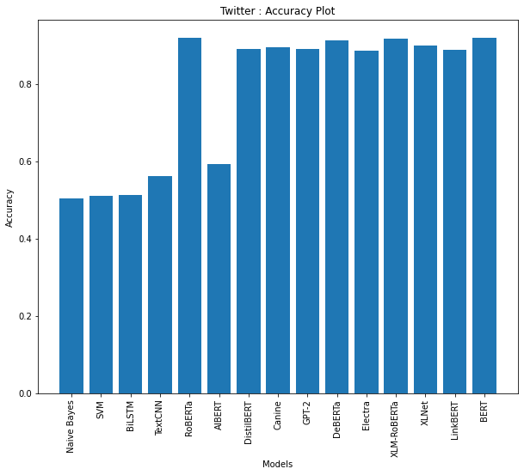
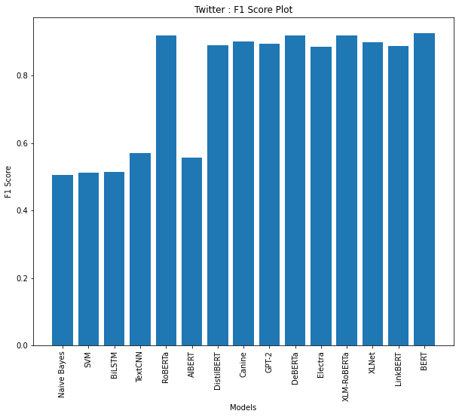
Accuracy and F1-score Results Train: Kaggle | Test: Twitter

Slide 8
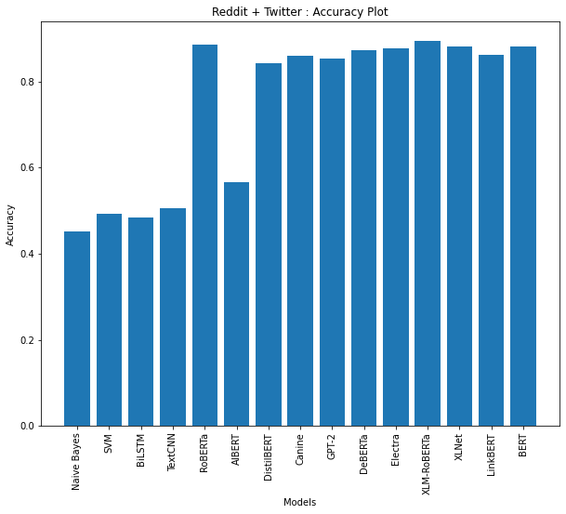
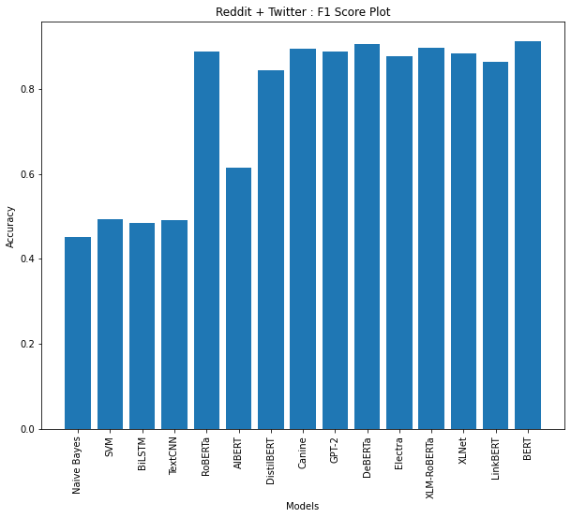
Accuracy and F1-score Results Train: Kaggle | Test: Reddit + Twitter

Slide 9
Conclusion:
We observe that the models perform well in the news classification task. The deep learning models perform better than the traditional ML methods.
A curious thing to note is that the CNN (Text CNN) and LSTM (BiLSTM) models performed at levels in close comparison with those of baseline methods. However, all the transformer models performed significantly better than the baseline ML, the CNN and the LSTM based models.
The accuracies produced by the Transformer models were good enough to classify most of the news data correctly. We also observe that the transformer models generalize well and one aspect to this might be because these models were pre-trained general language models and thus did not overfit on the training dataset.
One of the goals for our project was to figure whether a model trained to detect if a news article is real or fake and check if the structure of the text plays a part in that. From our results it can be observed that even with varying distributions with regards to the structure of the data, our models have generalized well.

Slide 10
Social Impact:
In a real-life setting where people largely consume news from social media handles, there is a huge possibility that we might be consuming fake news without knowing it and spread this out to friends, relatives and others which might lead to confusion and even pave the way to serious repercussions later.
In such cases, It would be great if people can have a system/setup to filter out the real news from the fake ones so that they can take the right and appropriate action (whatever it might be). They can also share the right news with others.
This is where Ground Zero plays its part. By being able to distinguish between real and fake news seamlessly, we can provide a setup where people access the right content always.

Slide 11
References:
Ahmed H, Traore I, Saad S. “Detecting opinion spams and fake news using text classification”, Journal of Security and Privacy, Volume 1, Issue 1, Wiley, January/February 2018.
Ahmed H, Traore I, Saad S. (2017) “Detection of Online Fake News Using N-Gram Analysis and Machine Learning Techniques. In: Traore I., Woungang I., Awad A. (eds) Intelligent, Secure, and Dependable Systems in Distributed and Cloud Environments. ISDDC 2017. Lecture Notes in Computer Science, vol 10618. Springer, Cham (pp. 127-138).
Train Dataset from Kaggle: https://www.kaggle.com/datasets/clmentbisaillon/fake-and-real-news-dataset

